Slide 1
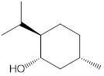
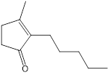
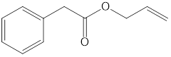
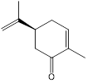
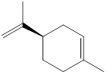
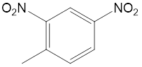
a
 | logEC50 | efficacy
DIJAS | -5.97 ± 0.08 | 1.00 ± 0.04
APA | -4.43 ± 0.09 | 0.82 ± 0.04
+CAR | -3.79 ± 0.09 | 0.83 ± 0.05
RLIM | -3.64 ± 0.07 | 0.42 ± 0.03
+MEN | -3.51 ± 0.10 | 0.18 ± 0.02
24DNT | ns | 0.19 ± 0.01
b
full agonist
weak agonist
APA
+MEN
DIJAS
RLIM
+CAR
24DNT
Notes:
Figure X. a. In vitro screening of 30 molecules on receptor OR1A1. Molecules name is abbreviated for clarity (see Table SXXX for correspondance). The y axis represents the firefly luminecense normalized to renilla firefly, empty vector control and basal activity. Each molecules is tested at 150uM without androstenone which is injected at 15uM. T-test p value between odors and 0uM are shown by stars (P<0.01 **; P<0.05 *). b. dose-response curves of OR1A1 inhibition on

Slide 2
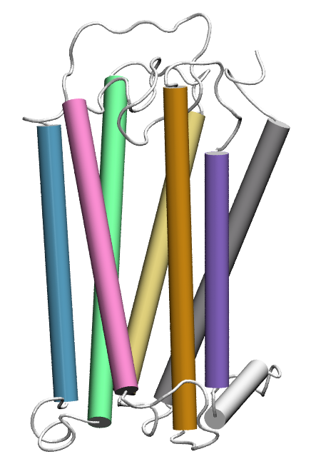
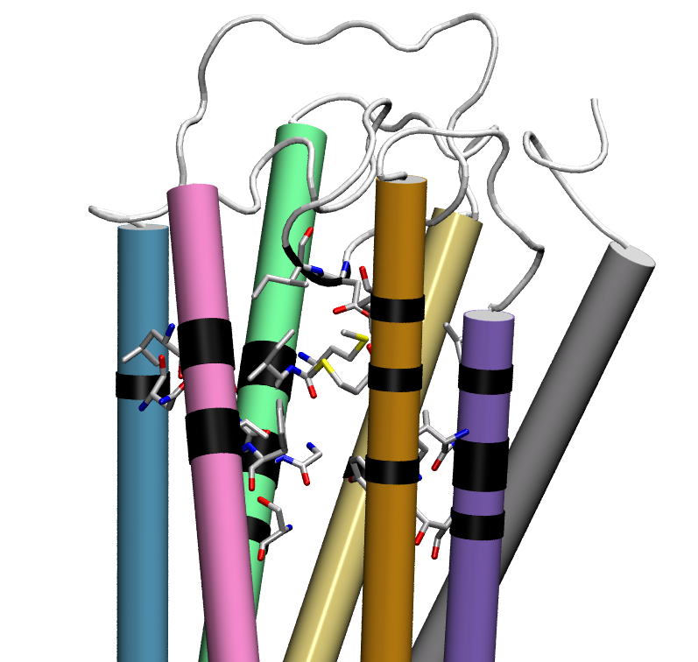
a
b
D180^{ECL2}
I181^{ECL2}
M104^{3.32}
L201^{5.42}
Y258^{6.55}
V274^{7.39}
Extracellular
F73^{2.53}
I105^{3.33}
N155^{4.56}
G202^{5.43}
M255^{6.52}
T277^{7.42}
G108^{3.36}
I205^{5.46}
Y251^{6.48}
A278^{7.43}
N109^{3.37}
F206^{5.47}
T280^{7.45}
S112^{3.40}
3
1
1
2
3
4
5
6
7
5
6
membrane
c
I181^{ECL2}
D180^{ECL2}
7
M104^{3.32}
I105^{3.33}
Y258^{6.55}
2
M255^{6.52}
4
L201^{5.42}
G202^{5.43}
V274^{7.39}
N155^{4.56}
Y251^{6.48}
I205^{5.46}
F206^{5.47}
T277^{7.42}
A278^{7.43}
Intracellular
G108^{3.36}
N109^{3.37}
T280^{7.45}
S112^{3.40}
F73^{2.53}

Slide 3
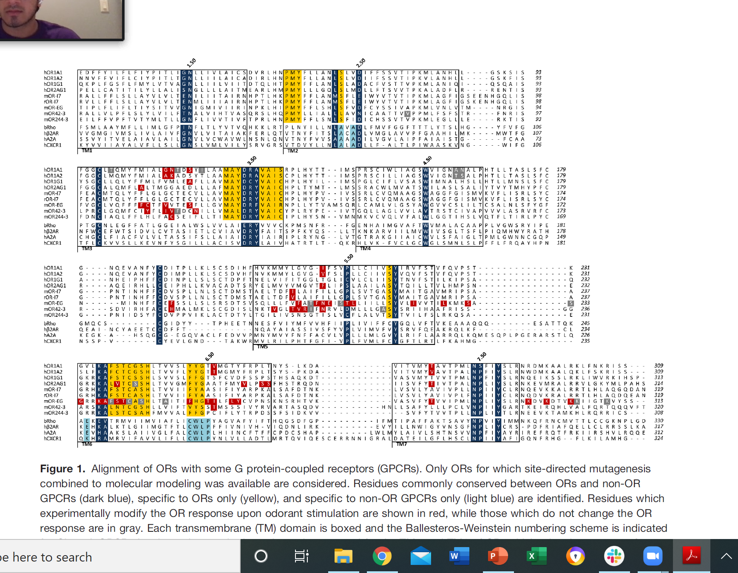

Slide 4
DIJAS 1µM
RLIM
APA 100µM
+MEN
+CAR 100µM
24DNT

Slide 5
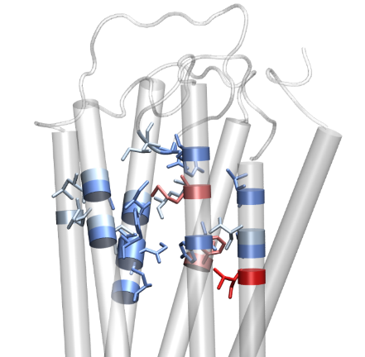
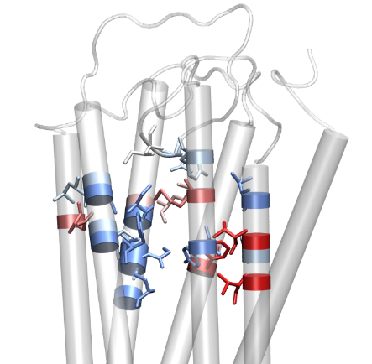
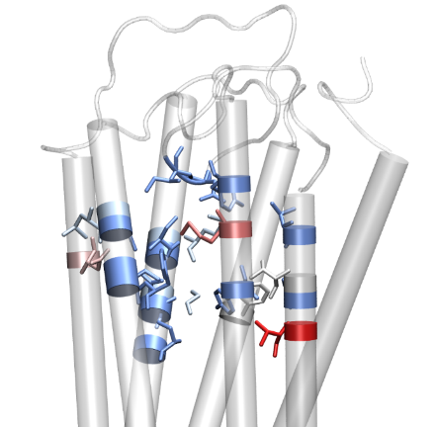
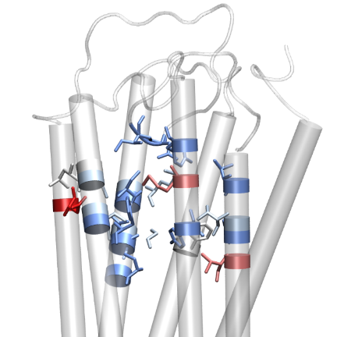
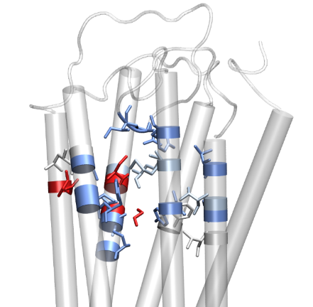
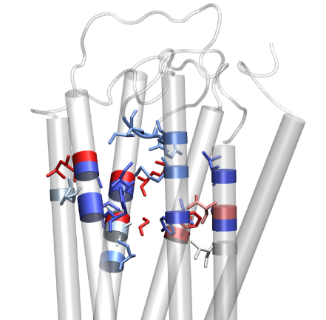
 | DIJAS | APA | CAR | RLIM | MEN | 24DNT |  | total
OR1A1
F73A
M104A
I105A
G108A
N109A
S112A
N155A
L201A
G202A
I205A
F206
Y251A
M255A
Y258A
V274A
T277A
A278L
T280A
D180A
I181A
DIJAS
APA
+CAR
>200
100
RLIM
+MEN
24DNT
<-100
Notes:
Change color of hitmap
Dose response
Cavity with hitmap
docking

Slide 7
discussion
Analyses structure/inhib
Analyse TM influence ago/inhib/ago-inhib

